Slide 1

The bug is not enough!

Slide 2

About me
15 years in IT, mainly in QA area
Passionate about Quality
I like to experiment new& old approaches
I believe that the extra mile makes the magic

Slide 3

Agenda
Higgs boson
The chaos 1-3
Quality questions
Structure & Formulas

Slide 4

Higgs boson
A product/company bought 7 years ago from Germany
In the first year the support is moved in Bucharest, Berlin team is dismissed
In the second year the RnD team is moved to Bucharest, Berlin team is dismissed
No clear & strong path to absorb the new project in the company ecosystem

Slide 5


The chaos- part 1
Context: Started to manage a new project which needed to become from a monolith to a cloud ready application
Problems:
150+ internal defects
60+ customer defects
1000+ tests
no clear architecture map

Slide 6

The chaos- part 2
Problems:
Few knowledge over the product in Bucharest
10 people team from which 4 of them left in the first month
QA team vanished ( 3 people left in the first month)
Low spirit in the team

Slide 7

The chaos- part 3
Strong Parts:
Tons of documentation
QMS process in place ( Jira, QC ALM, Jenkins)
Support team locally ( in Bucharest)

Slide 8


Next Steps
Go to www.menti.com and use the code 3336 3480

Slide 9
Quality questions
how can we find the most impacted areas by our developments for a milestone/service?
how many tests should we run for each impacted area?
if I have automated test, shall I run manual also?
are our tests focused

Slide 10
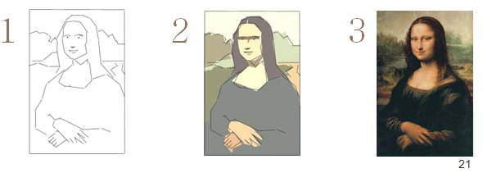
Align all data under the same umbrella
Export data from HP ALM Quality Center to Zephyr
All tests & Defects and US were moved under the right component
Complete the priority field for each test
Establish the mass for each item:
Epics– 10 points
Blocking incident- 10 points
Major incident- 5 points
Minor incident – 1 point
Notes:
What we have till this point:
All the data structured so we are able to see on each component how many US & incidents are and how many test ( manual & automated)
Why Epics and not user stories

Slide 11
Structure the data …in excel
Total mass & mass on the impacted features
Established an auto threshold ( 0.3)
Create a weighted average using the following formula:
(Component Mass * Capacity per day* Number of days)/ Total mass
– rounded to 0 decimals
Notes:
What we have till this point:
- All the data structured so we are able to see on each component how many US & incidents are and how many test ( manual & automated)

Slide 12
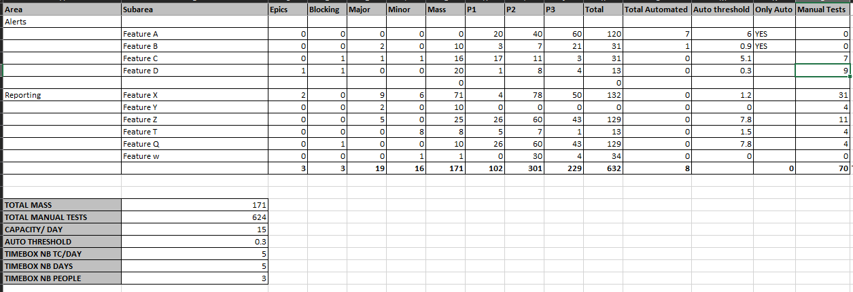
Excel presentation

Slide 13
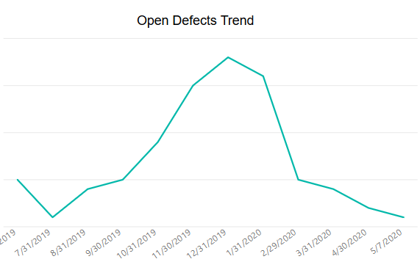
Impact on customer defects
Defect mass implementation
Joined the team

Slide 14
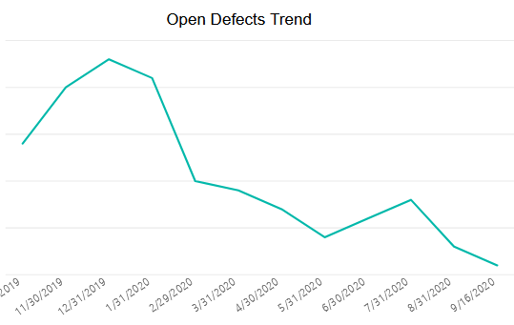
Impact on customer defects
Defect mass implementation

Slide 15

SumUp
Important Prereqs:
Good Requirements Coverage
Everything in the same tool ( Jira & Zephyr)
Defect mass is not the only silver bullet for a good test strategy
Multiple KPIs can help:
Defect Leakage = (Total Number of Defects Found in Product after release/ Total Number of Defects Found Before release) x 100
Defects by version
3 Months Defect Inflow

Slide 16


Feedback
Go to www.menti.com and use the code 3742 4746

Slide 17

https://github.com/vionascu/DefectMass

Slide 18




www.qachallengeaccepted.com
info@qachallengeaccepted.com
#qachallenge

